Slide 1

Acute Liver Injury
The art of pattern recognition
Mohammad Almeqdadi, MD

Slide 2
Basic Principles

Slide 3
“Liver Function Tests” vs
Liver Function Tests

Slide 4
Liver Integrity Tests | Liver Function Tests
AST | Albumin
ALT | Total Protein
ALP | PT/INR
GGT | Total Bilirubin
LDH

Slide 5
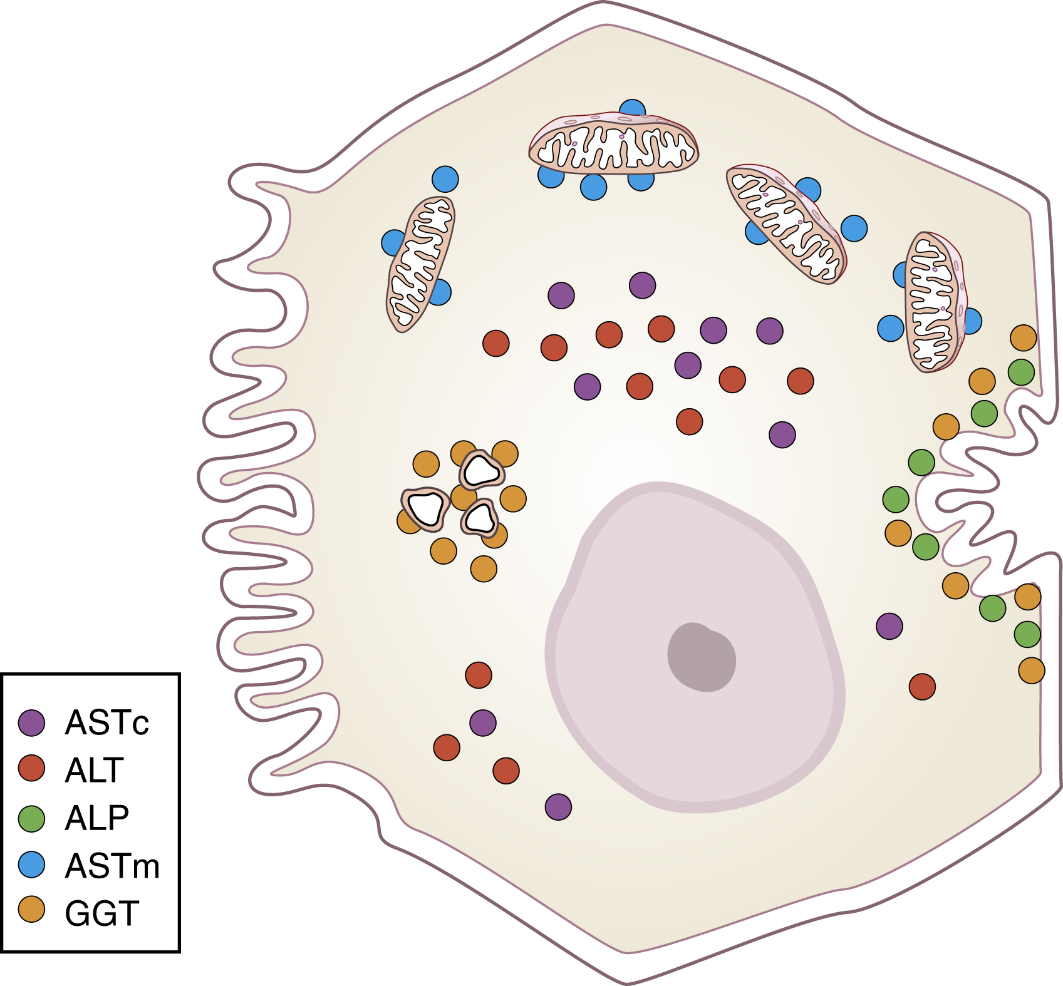
Sinusoidal side
(Blood)
Canalicular Side
(Bile)

Slide 6
Case Presentations
What’s the most likely diagnosis?

Slide 7
Lab | Case 1
AST | 7,000
ALT | 9,000
ALP | 800
GGT | 650
LDH | 7,000
Total Bilirubin | 2.0
Albumin | 3.0
Total Protein | 5.2
INR | 1.2
Platelets | 550,000
MCV | 92

Slide 8
Lab | Case 1
AST | 7,000
ALT | 9,000
ALP | 800
GGT | 650
LDH | 7,000
Total Bilirubin | 2.0
Albumin | 3.0
Total Protein | 5.2
INR | 1.2
Platelets | 550,000
MCV | 92
Ischemic hepatitis
R factor determines
  Hepatocellular vs cholestatic vs mixed
When you see hepatocellular injury in the 1000s, think the following
Acute viral hepatitis
Tylenol toxicity
Ischemic hepatitis (shock)
ALT:LDH < 1.5 is able to differentiate ischemic hepatitis

Slide 9
Lab | Case 2
AST | 300
ALT | 130
ALP | 120
GGT | 500
LDH | 150
Total Bilirubin | 5.0
Albumin | 4.0
Total Protein | 6.1
INR | 2.5
Platelets | 50,000
MCV | 102

Slide 10
Lab | Case 2
AST | 300
ALT | 130
ALP | 120
GGT | 500
LDH | 150
Total Bilirubin | 5.0
Albumin | 4.0
Total Protein | 6.1
INR | 2.5
Platelets | 50,000
MCV | 102
Alcoholic hepatitis
Notice AST:ALT > 2
Notice AST is in the 100s
  Remember, AST in the 1000s is not alcoholic hepatitis, and look for another cause
Elevated Tbili and INR define severity of alc hep
  Remember Maddrey Discriminant Function (MDF)
MDF is being replaced by MELD as it is more accurate in predicting mortality

Slide 11
Lab | Case 4
AST | 9,000
ALT | 12,000
ALP | 1,000
GGT | 900
LDH | 5,000
Total Bilirubin | 5.0
Albumin | 2.7
Total Protein | 4.9
INR | 3.5
Platelets | 210,000
MCV | 85
Lipase | 1,000

Slide 12
Lab | Case 4
AST | 9,000
ALT | 12,000
ALP | 1,000
GGT | 900
LDH | 5,000
Total Bilirubin | 5.0
Albumin | 2.7
Total Protein | 4.9
INR | 3.5
Platelets | 210,000
MCV | 85
Lipase | 1,000
Tylenol toxicity
Remember when you see ALT > 10,000, think Tylenol
Can end up in massive hepatic necrosis and ALT levels fall to normal
  Here, INR and Tbili will be elevated
Acute pancreatitis can also result from Tylenol
Do not delay NAC if Tylenol is suspected!
MELD > 32 = transplant referral

Slide 13
Lab | Case 5
AST | 10,000
ALT | 30
ALP | 80
GGT | 100
LDH | 5,000
Total Bilirubin | 1.0
Albumin | 4.0
Total Protein | 6.2
INR | 1.0
Platelets | 190,000
MCV | 80

Slide 14
Lab | Case 5
AST | 10,000
ALT | 30
ALP | 80
GGT | 100
LDH | 5,000
Total Bilirubin | 1.0
Albumin | 4.0
Total Protein | 6.2
INR | 1.0
Platelets | 190,000
MCV | 80
Rhabdomyolysis
  Could also be cardiac muscle (STEMI), but would not expect it in the 1000s
Normal ALT = no liver injury
Isolated AST elevation = extrahepatic sources
  Skeletal muscle
  Cardiac muscle
  RBCs
  Kidney
  Etc.

Slide 15
Lab | Case 3
AST | 6,000
ALT | 2,500
ALP | 400
GGT | 550
LDH | 700
Total Bilirubin | 1.2
Albumin | 3.1
Total Protein | 5.6
INR | 1.2
Platelets | 50,000
MCV | 102

Slide 16
Lab | Case 3
AST | 6,000
ALT | 2,500
ALP | 400
GGT | 550
LDH | 700
Total Bilirubin | 1.2
Albumin | 3.1
Total Protein | 5.6
INR | 1.2
Platelets | 50,000
MCV | 102
Acute liver injury in the setting of chronic alcohol drinking
Notice the AST:ALT > 2
  Because it’s in the 1000s, it is unlikely alc hep
The following are hallmarks of alcohol drinking
  Elevated GGT (even without ALP)
  Elevated MCV
  Low platelets
  AST:ALT>2 (regardless of levels)

Slide 17
Lab | Case 6
AST | 50
ALT | 60
ALP | 500
GGT | 700
LDH | 100
Total Bilirubin | 4.5
Albumin | 4.0
Total Protein | 6.2
INR | 1.5
Platelets | 190,000
MCV | 80

Slide 18
Lab | Case 6
AST | 50
ALT | 60
ALP | 500
GGT | 700
LDH | 100
Total Bilirubin | 4.5
Albumin | 4.0
Total Protein | 6.2
INR | 1.5
Platelets | 190,000
MCV | 80
Cholestatic injury
R factor < 2
  mainly ALP and GGT elevation
Next step is RUQ US to evaluate ductal dilation
Extrahepatic cholestasis
  Choledocholithiasis
  Tumors
  Strictures (PSC)
Intrahepatic cholestasis
  Sepsis
  Drug induced (DILI)
  PBC

Slide 19
Lab | Case 6
AST | 50
ALT | 60
ALP | 500
GGT | 700
LDH | 100
Total Bilirubin | 4.5
Albumin | 4.0
Total Protein | 6.2
INR | 1.5
Platelets | 190,000
MCV | 80
Cholestatic injury
Why is the INR elevated?
Vit K deficiency
  Remember, no bile = no ADEK absorption = high INR
  Liver function is intact
Give Vit K IV not PO

Slide 20
Lab | Case 7
AST | 20
ALT | 30
ALP | 500
GGT | 80
LDH | 100
Total Bilirubin | 0.5
Albumin | 4.0
Total Protein | 6.2
INR | 1.0
Platelets | 190,000
MCV | 80

Slide 21
Lab | Case 7
AST | 20
ALT | 30
ALP | 500
GGT | 80
LDH | 100
Total Bilirubin | 0.5
Albumin | 4.0
Total Protein | 6.2
INR | 1.0
Platelets | 190,000
MCV | 80
Extrahepatic ALP
ALP without GGT elevation confirms an extrahepatic source
ALP isoenzymes found in:
  Hepatocytes (canalicular side)
  Cholangiocytes (biliary tree)
  Intestinal epithelium (SBO)
  Kidney (CKD/AKI)
  Bone (osteoblastic, not lytic)
  Placenta (1st + 3rd trimester)

Slide 22
Lab | Case 8
AST | 30
ALT | 15
ALP | 80
GGT | 800
LDH | 100
Total Bilirubin | 0.5
Albumin | 4.0
Total Protein | 6.2
INR | 1.0
Platelets | 100,000
MCV | 102

Slide 23
Lab | Case 8
AST | 30
ALT | 15
ALP | 80
GGT | 800
LDH | 100
Total Bilirubin | 0.5
Albumin | 4.0
Total Protein | 6.2
INR | 1.0
Platelets | 100,000
MCV | 102
Alcohol drinking
Remember the hallmarks of drinking
  Elevated GGT (induced elevation without liver injury)
  AST:ALT>2 (vit B6 deficiency)
  Elevated MCV
  Low platelets
  Elevated IgA levels

Slide 24
Lab | Case 9
AST | 50
ALT | 60
ALP | 1,000
GGT | 700
LDH | 100
Total Bilirubin | 0.5
Albumin | 4.0
Total Protein | 6.2
INR | 1.0
Platelets | 190,000
MCV | 80

Slide 25
Lab | Case 9
AST | 50
ALT | 60
ALP | 1,000
GGT | 700
LDH | 100
Total Bilirubin | 0.5
Albumin | 4.0
Total Protein | 6.2
INR | 1.0
Platelets | 190,000
MCV | 80
Infiltrative liver injury
ALP and GGT elevation without Tbili elevation
Examples:
  Sarcoidosis
  Syphilis
  Drug-induced liver injury
  Early PBC
  Infiltrative carcinomas

Slide 26
Lab | Case 10
AST | 30
ALT | 12
ALP | 80
GGT | 80
LDH | 100
Total Bilirubin | 1.2
Albumin | 3.5
Total Protein | 4.8
INR | 1.3
Platelets | 140,000
MCV | 90

Slide 27
Lab | Case 10
AST | 30
ALT | 12
ALP | 80
GGT | 80
LDH | 100
Total Bilirubin | 1.2
Albumin | 3.5
Total Protein | 4.8
INR | 1.3
Platelets | 140,000
MCV | 90
Cirrhosis
Hallmarks of cirrhosis on labs
  AST>ALT (even normal ranges)

Slide 28
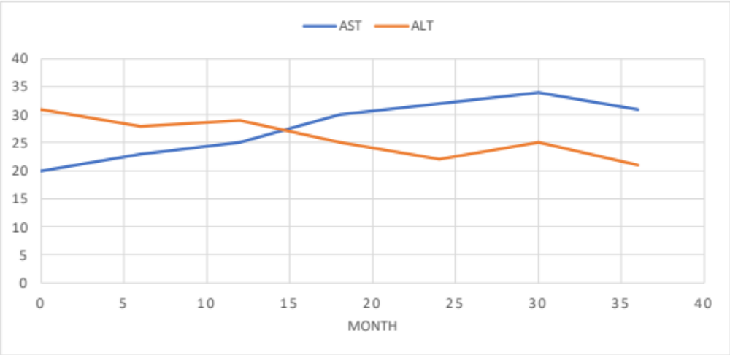
AST>ALT in Cirrhosis

Slide 29
Lab | Case 10
AST | 30
ALT | 12
ALP | 80
GGT | 80
LDH | 100
Total Bilirubin | 1.2
Albumin | 3.5
Total Protein | 4.8
INR | 1.3
Platelets | 140,000
MCV | 90
Cirrhosis
Hallmarks of cirrhosis on labs
  AST>ALT (even normal ranges)
  Low albumin
  Elevated INR
  Elevated Tbili
  Low platelets (indicates portal hypertension!)

Slide 30
Lab | Case 11
AST | 30
ALT | 60
ALP | 100
GGT | 80
LDH | 80
Total Bilirubin | 1.0
Albumin | 4.0
Total Protein | 6.0
INR | 1.0
Platelets | 250,000
MCV | 80

Slide 31
Lab | Case 11
AST | 30
ALT | 60
ALP | 100
GGT | 80
LDH | 80
Total Bilirubin | 1.0
Albumin | 4.0
Total Protein | 6.0
INR | 1.0
Platelets | 250,000
MCV | 80
Chronic liver disease
ALT (sometimes AST and others) is mildly elevated
  ALT>AST
Work up of all causes of chronic liver diseases
  Chronic hep B
  Chronic hep C
  Hemochromatosis
  Autoimmune hepatitis/etc.
  A1ATD
  Wilson’s
  NAFLD ← exclude others first

Slide 32
Lab | Case 12
AST | 400
ALT | 30
ALP | 90
GGT | 80
LDH | 1,000
Total Bilirubin | 10.0
Albumin | 4.0
Total Protein | 6.0
INR | 3.0
Platelets | 50,000
MCV | 110

Slide 33
Lab | Case 12
AST | 400
ALT | 30
ALP | 90
GGT | 80
LDH | 1,000
Total Bilirubin | 10.0
Albumin | 4.0
Total Protein | 6.0
INR | 3.0
Platelets | 50,000
MCV | 110
Hemolysis
Elevated AST with no elevation in ALT indicates extrahepatic AST
Elevated LDH, Tbili and MCV indicates hemolysis
Elevated INR and low platelets may indicate DIC here!

Slide 34
Lab | Case 13
AST | 800
ALT | 300
ALP | 15
GGT | 200
LDH | 500
Total Bilirubin | 40.0
Albumin | 2.1
Total Protein | 4.8
INR | 3.5
Platelets | 100,000
MCV | 110

Slide 35
Lab | Case 13
AST | 800
ALT | 300
ALP | 15
GGT | 200
LDH | 500
Total Bilirubin | 40.0
Albumin | 2.1
Total Protein | 4.8
INR | 3.5
Platelets | 100,000
MCV | 110
Acute Wilson’s disease
AST:ALT > 2.2
ALP:Tbili < 4
  “low ALP”
  Tbili is out of proportion to ALP
Supportive evidence
  Non-immune hemolytic anemia
    Tbili is high
    LDH is high
    MCV is high
  INR is elevated indicating liver failure
This patient requires transplant referral!

Slide 36
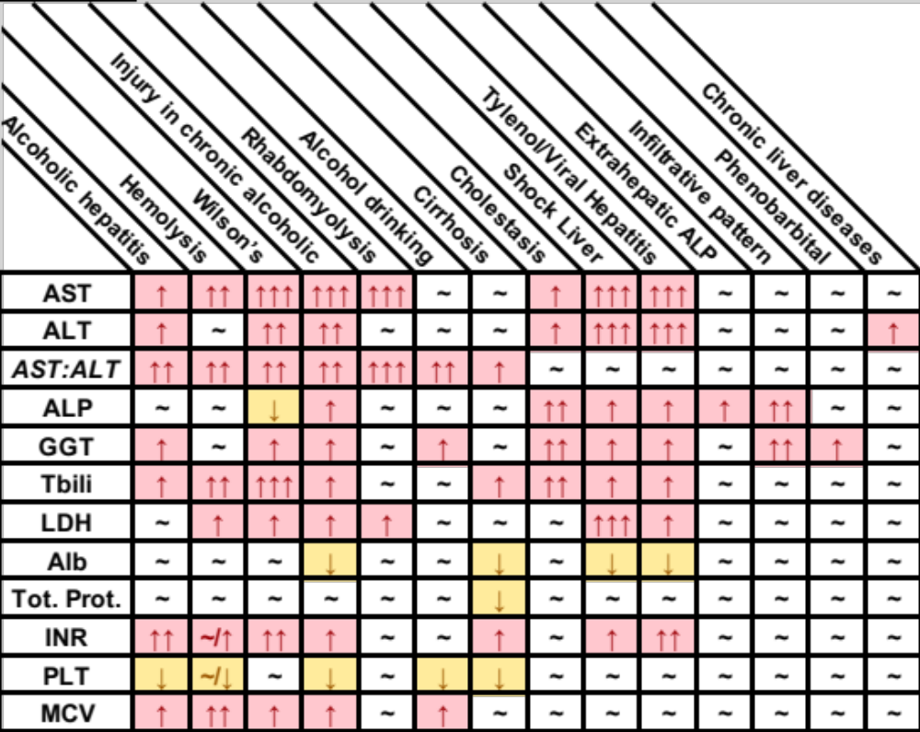

Slide 37
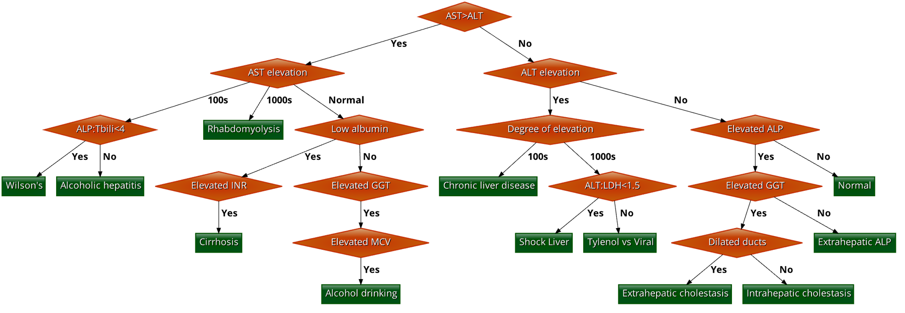

Slide 38
Thank you!

